Slide 1


DATA STRUCTURES USING C Lecture 4
Prof. P. S. Avadhani
M. Tech., PhD., F.I.E,FCSI, FAPAS.
Visiting Professor, Central University of Odisha
Former Director, IIIT, Agartala
Former Principal, AU College of Engg,
Andhra University, Visakhapatnam

Slide 2
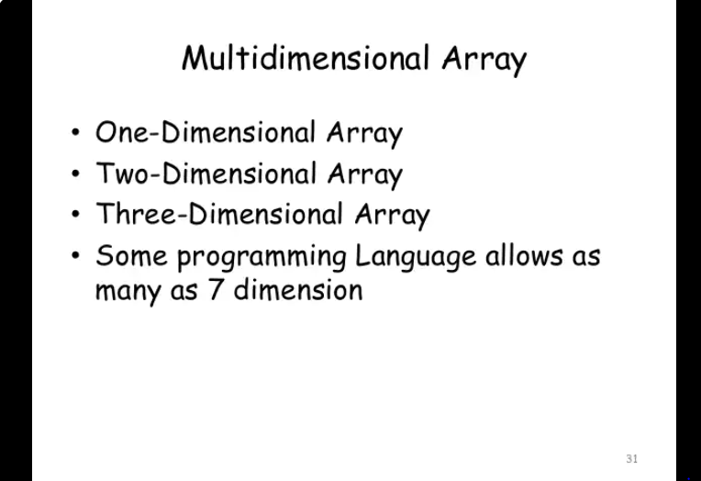

Slide 3
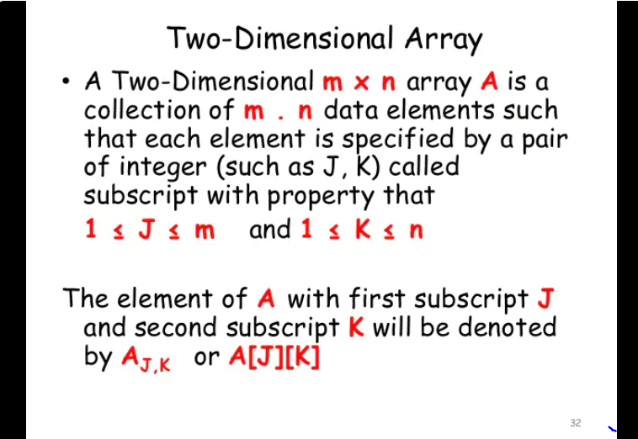

Slide 4
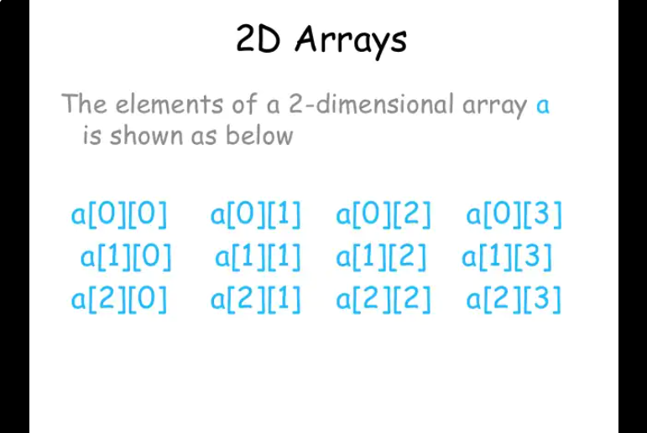

Slide 5
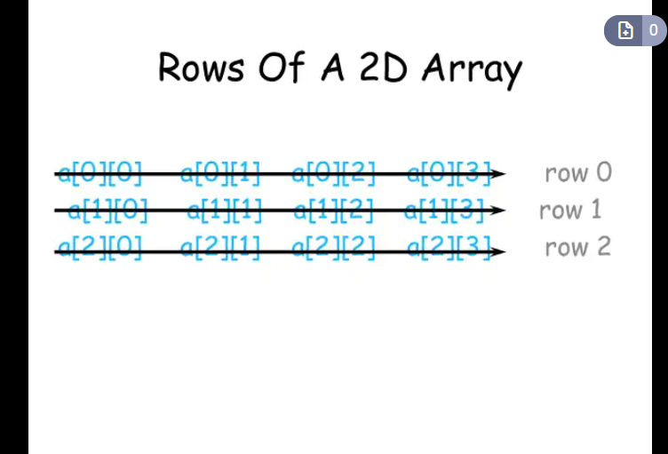

Slide 6
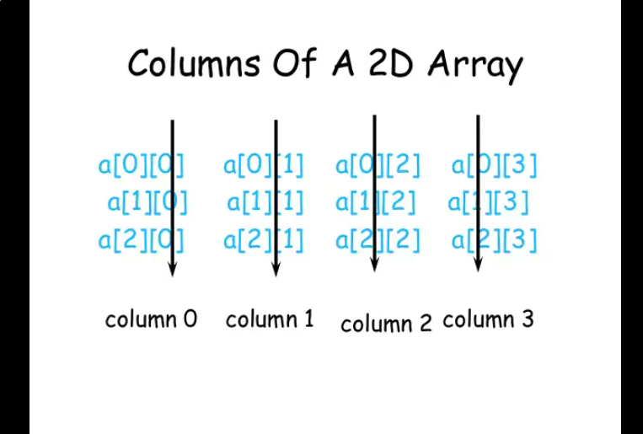

Slide 7
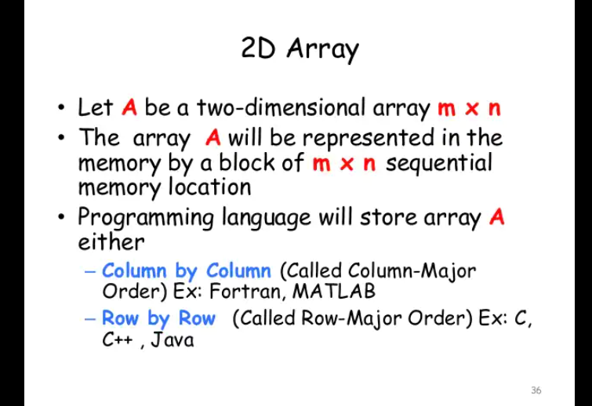

Slide 8
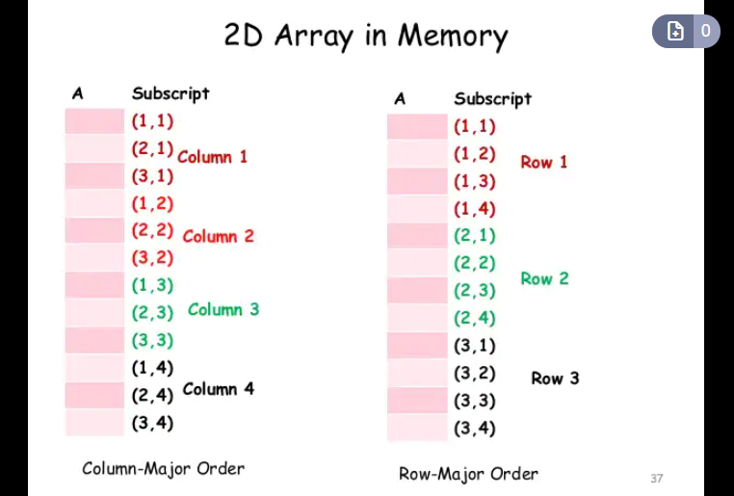

Slide 9
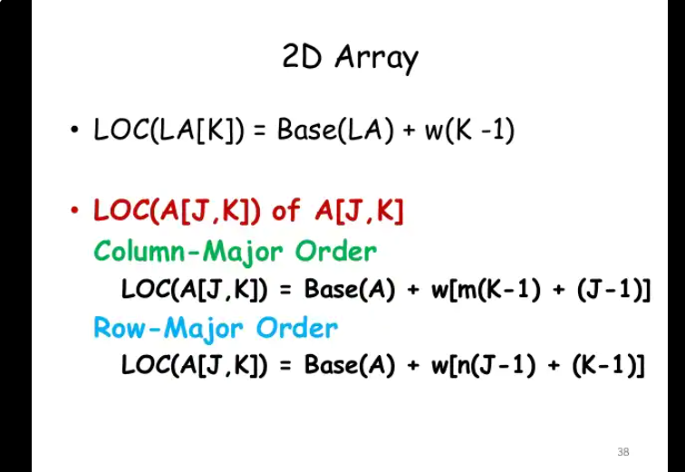

Slide 10
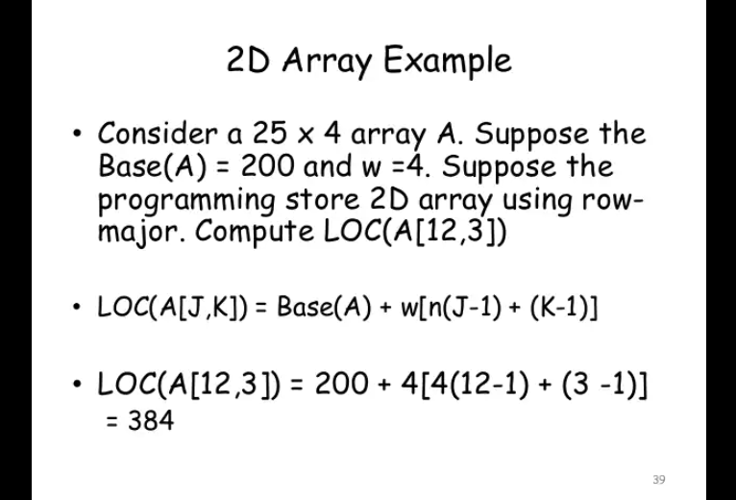

Slide 11
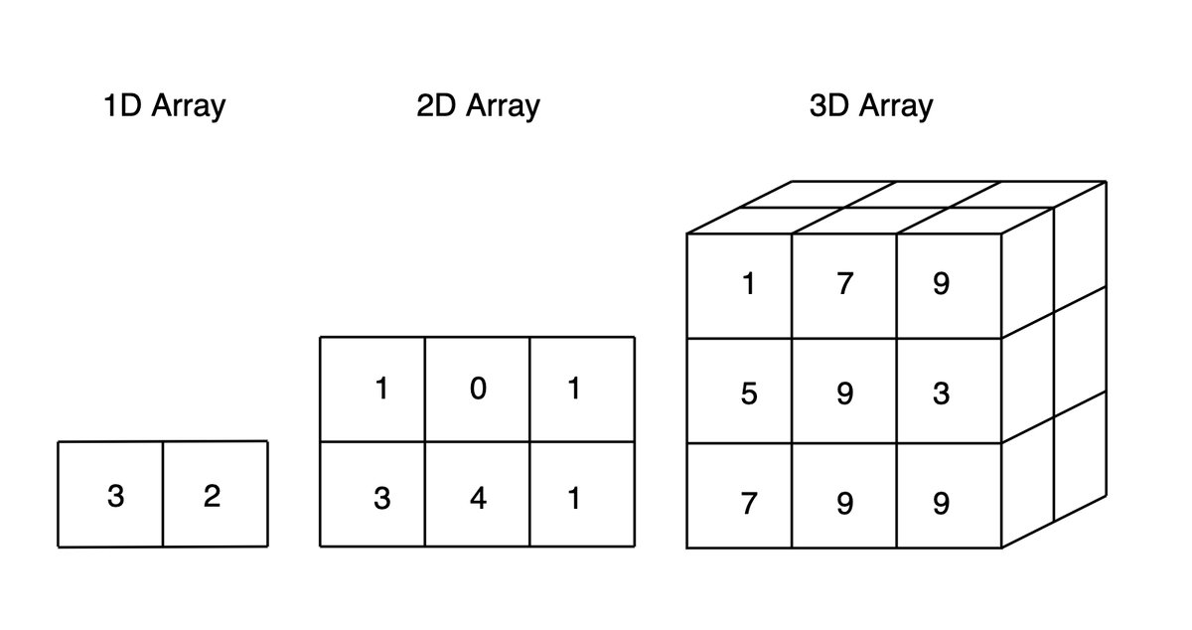
Three-Dimensional Array

Slide 12
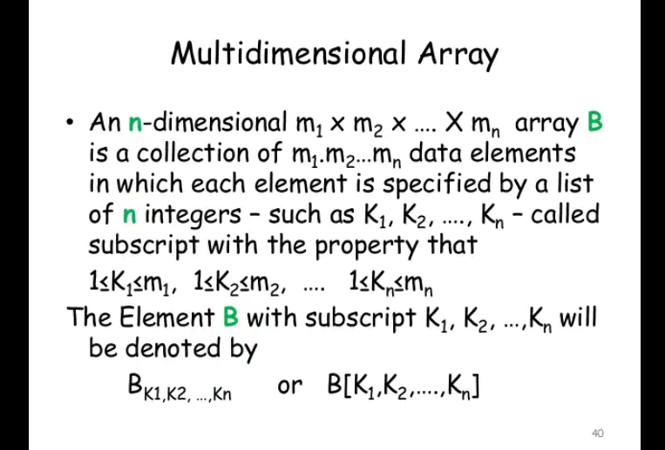

Slide 13
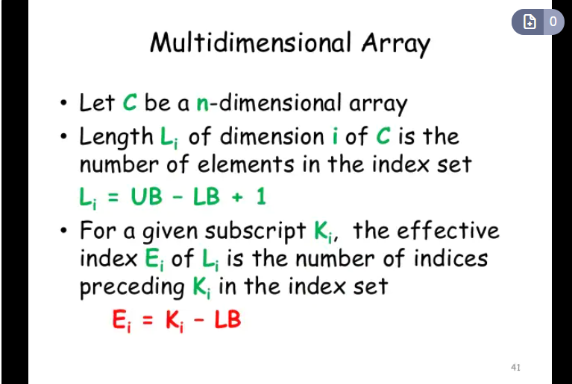

Slide 14
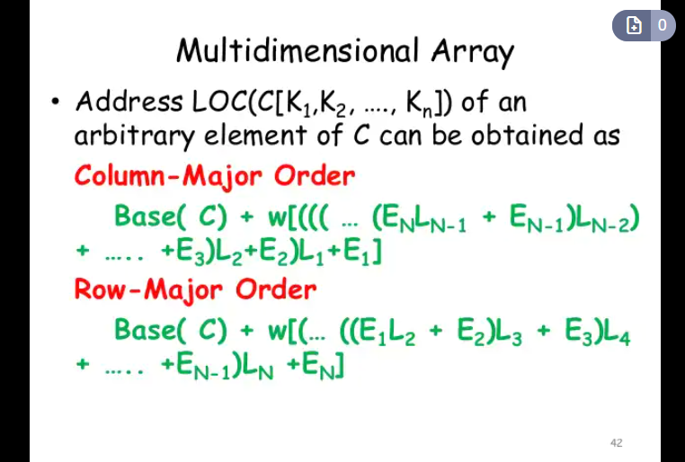

Slide 15
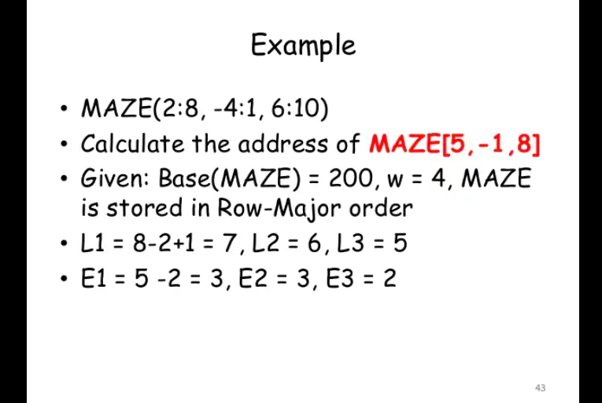
K1 = 5, K2 = -1, K3 = 8, LB1 = 2, LB2 = -1, LB3 = 6

Slide 16
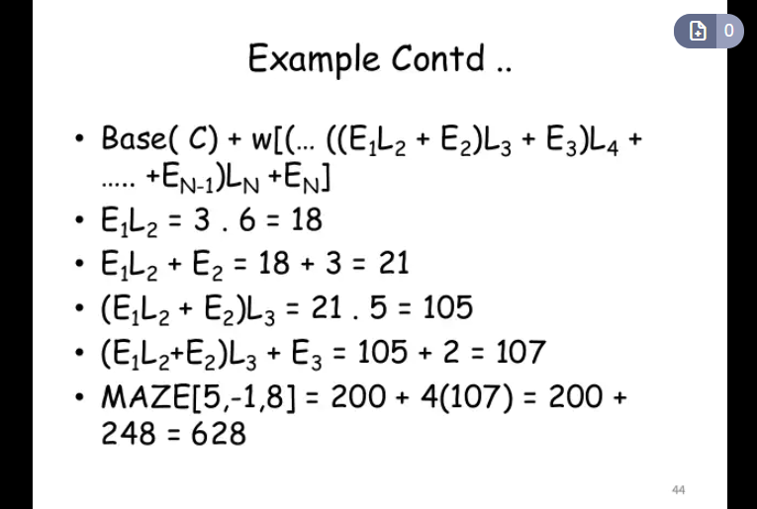

Slide 17
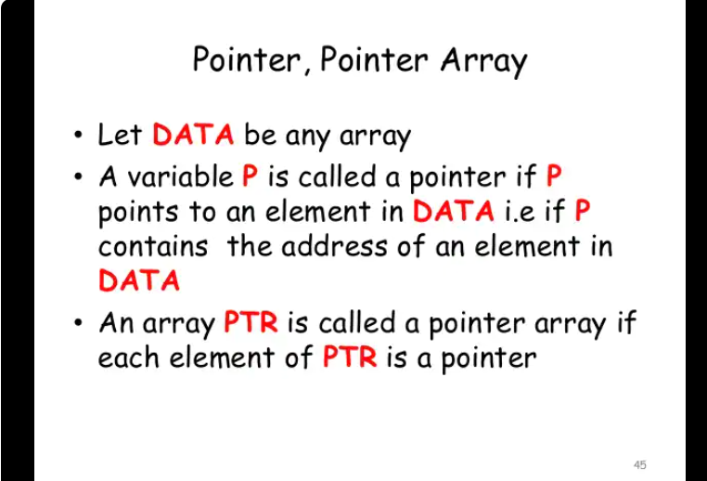

Slide 18
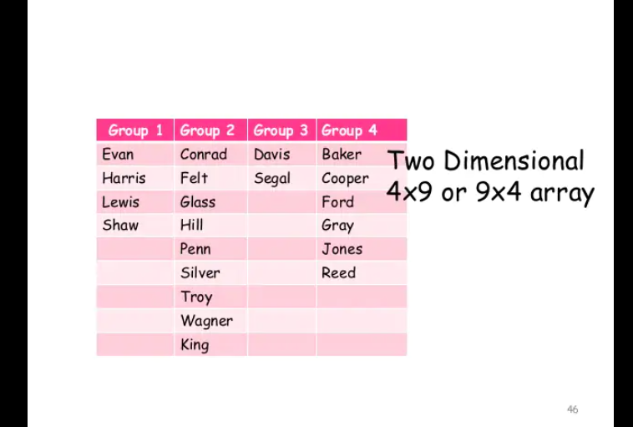

Slide 19
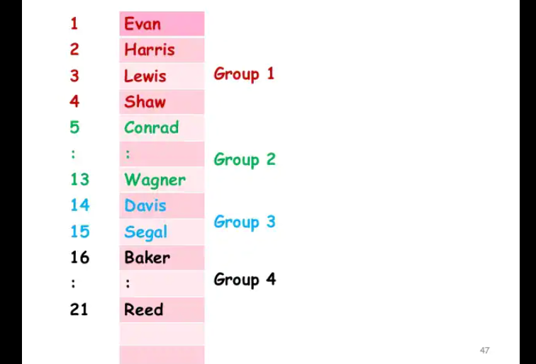

Slide 20
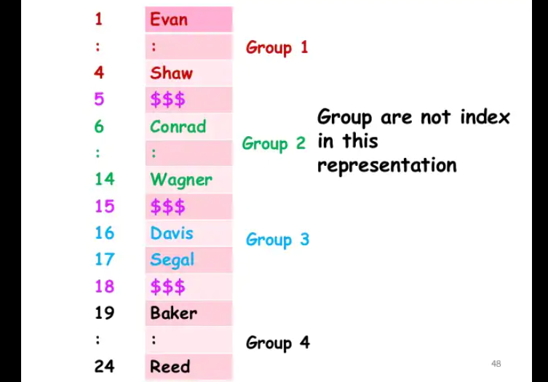

Slide 21
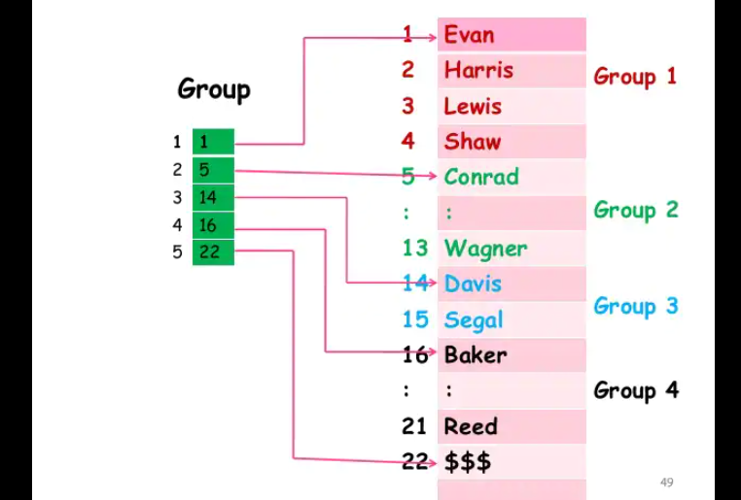

Slide 22
Character string operations

Slide 23
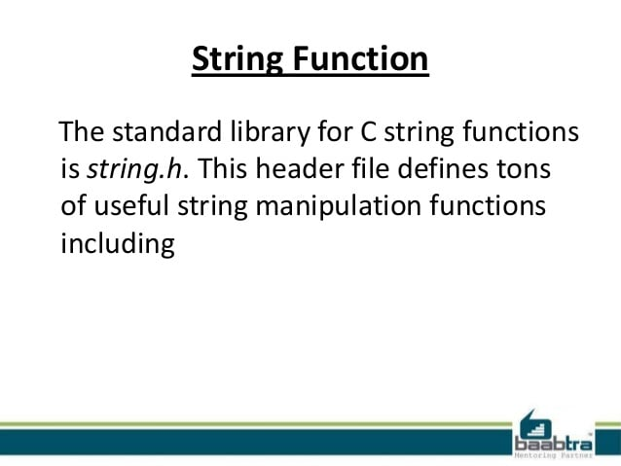

Slide 24
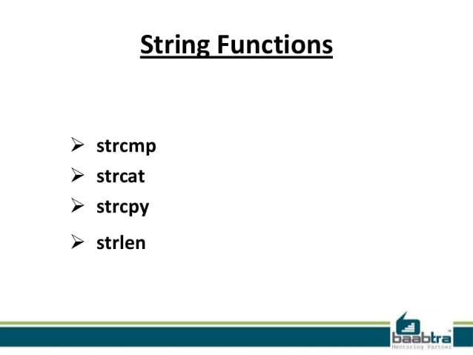

Slide 25
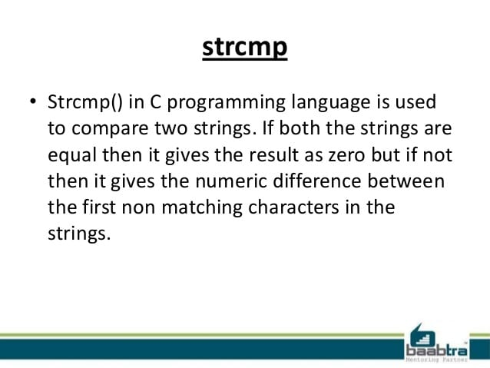

Slide 26
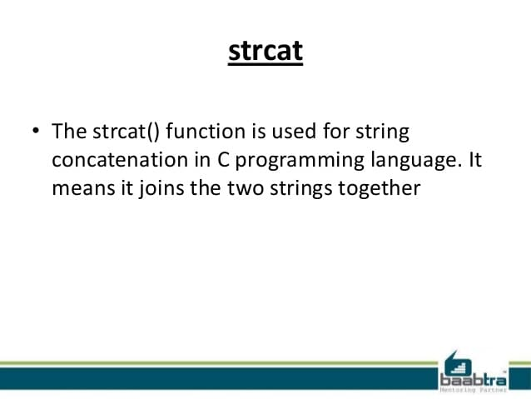

Slide 27
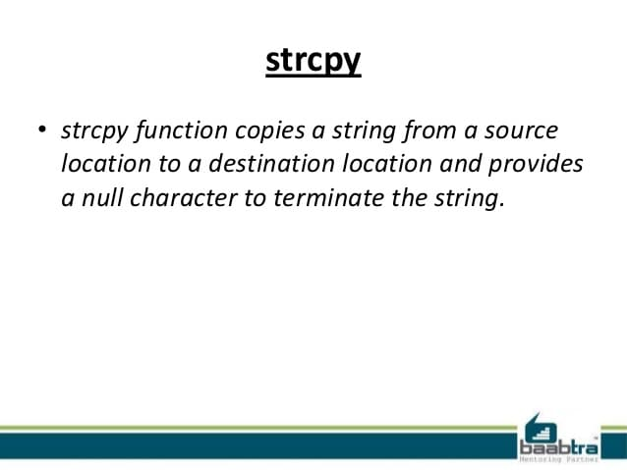

Slide 28
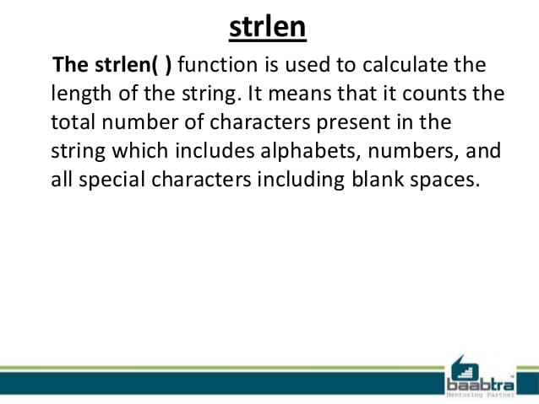

Slide 29
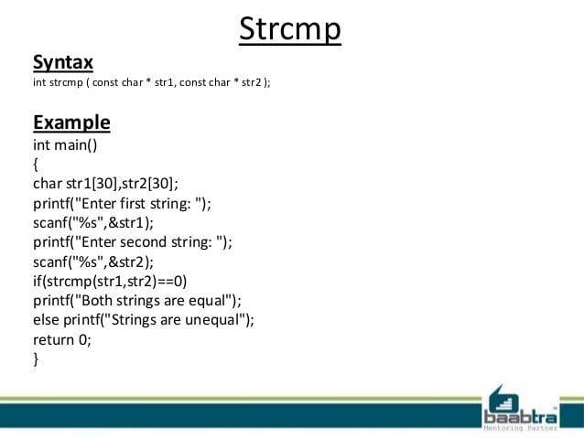

Slide 30
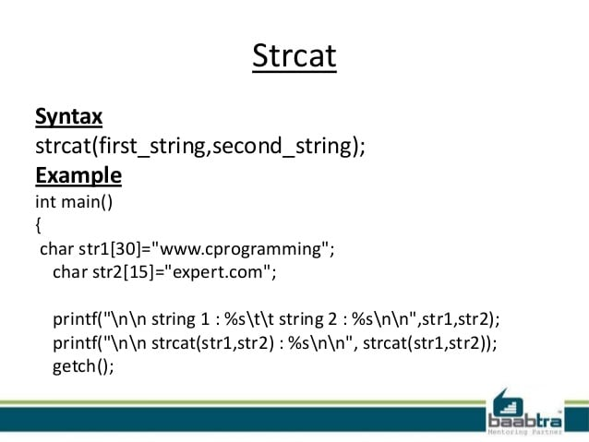

Slide 31
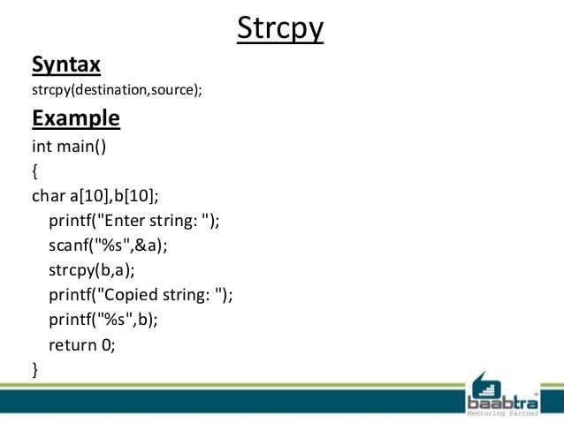

Slide 32
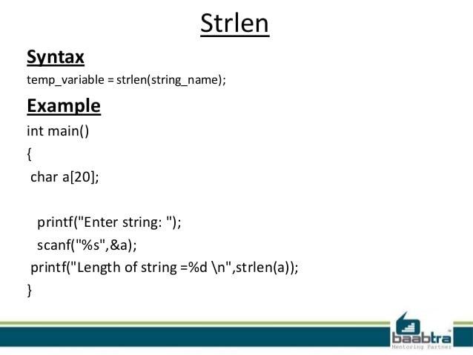

Slide 33
/* C program to accept a string and a substring and check if the substring is present in the given string */
#include<stdio.h>
#include<conio.h>
void main()
{
char str[80],search[10];
int count1=0,count2=0,i,j,flag; clrscr();
puts("Enter a string:");
gets(str);
puts("Enter search substring:");
gets(search);
while (str[count1]!='\0’) count1++;
while (search[count2]!='\0’) count2++;
for(i=0;i<=count1-count2;i++) {
for(j=i;j<i+count2;j++){ flag=1;
if (str[j]!=search[j-i]) { flag=0; break; }
}
if (flag==1) break;
}
if (flag==1) puts("SEARCH SUCCESSFUL!");
else puts("SEARCH UNSUCCESSFUL!");
getch();
}

Slide 34
Output
Enter a string:
Hello how are you?
Enter search substring:
how
SEARCH SUCCESSFUL!
Every string in C language ends with the charecters \0. (Remember it is backslash followed by zero, not the ordinary slash)

Slide 35
THANK YOU

